Slide 1
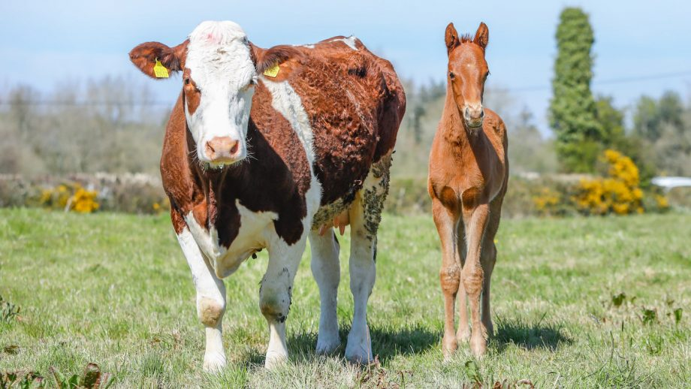
AI Lifecycle – Week 2 – First Presentation
Ten Possible Ideas for this course
Music Recommender System
Single Feature Extraction from Music
Touch Screen Surface Interaction
Sign Language Speech to Text
Cryptocurrency and Stock Market Prediction Model with Expert Insight
Fish Swimming Movement Analysis
Horse / Dog Breed Classifier
Dairy Farming Assistance
Classification of Fake and Genuine Reviews
Automated Recipe Generation from a Picture
Our Top 3 Choices
Notes:
This concept revolves around advanced audio processing techniques, specifically converting music into vector space and conducting similarity analysis. Unlike conventional recommender models, our approach focuses solely on audio content, omitting user-based factors. An additional experiment involves applying Fast Fourier Transform (FFT) to the audio files, as part of the data pre-processing.
Business Problem: It is a part of a bigger idea for a social network for musicians and music enthusiasts (details about the platform are irrelevant now). To keep user in the platform we should let them explore content they might like. We want to explore a new way of matching the audio to perform similarity, using that way we ensure equal chances to new content to be recommended.
Data: Spotify data can be used for a recommender system, then running the data through an existing model should give us similarities between song, hopefully.
Another way is by using the playlists as data, assume that all tracks in a playlist are similar.
But as for proof of concept it is maybe good to try first to classify genres of songs based on the audio only.
The data contains text only, then for using the audio we match the name of the track to a name of YouTube song video, Spotify or illegally downloaded music (if we use it only for the course).
Models: Exploring whether we can use FFT and use the output as input for the model. Then after converting the audio to vector space, we will perform similarity check with FAISS.
Recent Work: There are some articles online about genre classification that are worth checking out and possibly utilize the models proposed there to perform our task.
Ethical Consideration: Getting copyright protected data will make the models useless for a business but can still be interesting for the scope of the course only.

Slide 2


IDEA 1: Music Recommender System
AI Lifecycle – Week 2 – First Presentation
Constantly recommending similar, yet refreshing song choices to users to ensure they remain interested in the music platform
The Data Required
Models / Recent Work
Music data set from the Spotify data could be used. This dataset consist of sound tracks from public playlist of US Spotify users. An alternative dataset is the Million Song Dataset. This dataset only provide descriptors on the song. Song tracks have to be obtained via a different methods.
Preprocessing of audio tracks to vector space required before similarity comparison
A model for the classifying of song genre suggested the use of Principal Component Analysis (PCA), followed by decision tree to classify song genre. Others suggest the use of K-means clustering.
We would like to attempt to augment the dataset by using Fast Fourier Transform (FTT) to compare similarities of audio sound tracks. We could also use the Facebook AI Similarity Search (FAISS) library to quickly search for embeddings of multimedia documents that are similar to each other.
Ethical Considerations
Copyright protected data and audio song tracks, Personal data privacy concerns, User autonomy to disable function

Slide 3

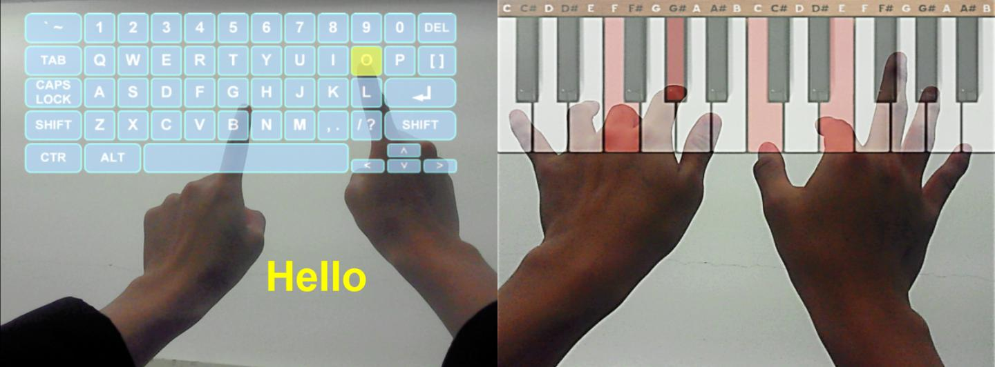
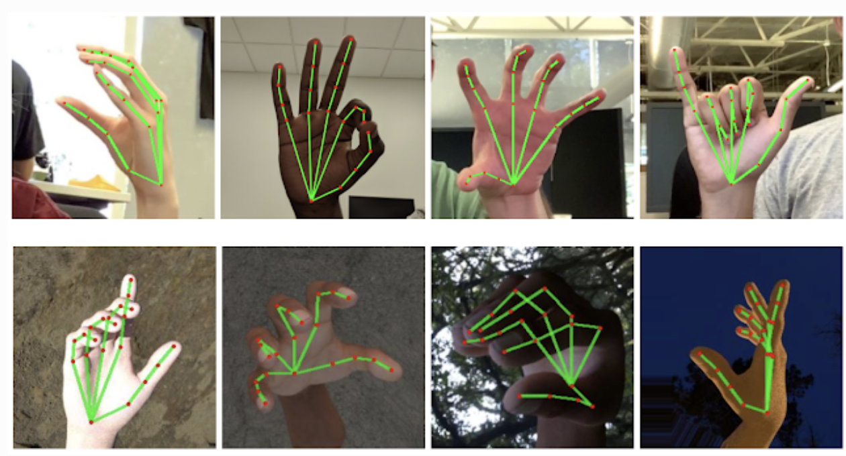
IDEA 3: Touch Screen Surface Interaction
AI Lifecycle – Week 2 – First Presentation
Utilize a webcam to enable any surface to function as a touch screen - Enables the user to view an augmented reality input device on the table surface, detects the user taps on the surface via a camera and converts it to input data for an app.
The Data Required
Models / Recent Work
Manually Recording of fingers typing to produce data required for model training
Existing models / methods:
For Hand Detection and Tracking......
MediaPipe: employs ML to infer 21 3D landmarks of a hand from a single frame --> detect finger tips
OpenCV: Videocapture, image processing methods
Ethical Considerations
Personal data privacy concerns, accessibility for everyone, ability to exploit the model to spy on people using their laptop in public places.

Slide 4

IDEA 4: Sign Language Speech to Text
AI Lifecycle – Week 2 – First Presentation
Convert signed speech to text to bridge gap in communication between deaf person and hearing person (with no knowledge of sign language)
The Data Required
Models / Recent Work
Sign Language Dataset which can be used:
American Sign Language Lexicon Video Dataset (ASLLVD):
A large-scale dataset for Word-Level American Sign Language
Sign Language MINST
Data can also be extracted from videos containing sign language captions using existing audio and video tools
Existing models / methods:
Research Paper - "Efficient deep learning models based on tension techniques for sign language recognition" --> Integrating attention module (CBAM) into YOLO-based deep learning models
Natural Language-Assisted Sign Language Recognition (NLA-SLR) framework
Hugging Face Model – Sign-Language by RavenOnur: Image classfication of Sign Language Letters
Most existing methods were tried on words or short phrases. Therefore, there is a need to increase accuracy of models for longer phrases or sentences.
Ethical Considerations
Accuracy to avoid miscommunications and misunderstandings, personal data privacy concerns, accessibility and inclusive design

Slide 5

Thank you
Questions?

